Slide 1

Session Name:
Integer Programming: Formulating and Solving Problems
Delivered By:
Mr. Ritwik Sinha

Slide 2

Integer Programming Problem
Integer Programming (IP) is a type of optimization problem where some or all of the decision variables must take integer values.
But you're not allowed to use fractional values for decision variables — they must be whole numbers, such as:
In real-world situations like :
How many buses to schedule? (can’t send 2.3 buses)
How many factories to build? (can’t build 1.7 factories)

Slide 3



CU ONLINE LMS APP
For Android Users:
Open the Google Play Store on your device and search for "CU Online LMS App".
Tap the app from the search results and select Install.
Once installed, tap Open or locate the app on your home screen.
Log in using your LMS credentials.
👉 Download Now: Playstore Link
For IOS Users:
Open the Apple Play Store on your device and search for "CU Online LMS App".
Tap the app from the search results and select Install.
Once installed, tap Open or locate the app on your home screen.
Log in using your LMS credentials.
👉 Download Now: App Store Link

Slide 4
Learning Objectives
By the end of this session, you will be able to:
Discuss different types of Integer Programming
Discuss the algorithms required to solve Integer Programming Problem
Formulate and solve integer programming problem

Slide 5
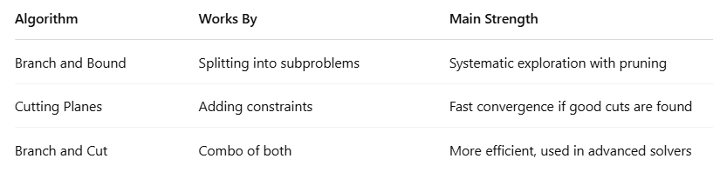
Algorithms for solving Integer Programming Problem
The three core algorithms to solve integer programming problems are:
Branch and Bound
Cutting Planes
Branch and Cut

Slide 6
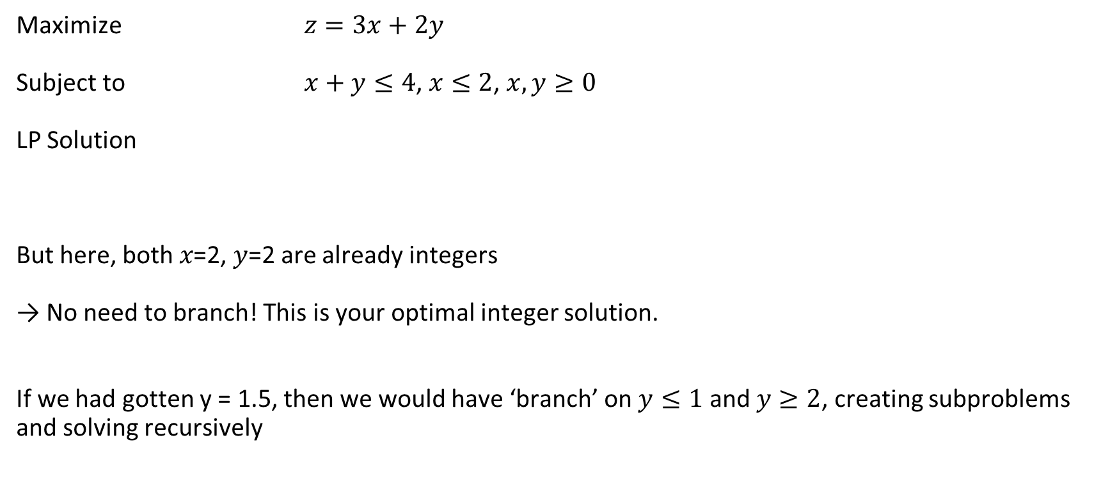
Branch and Bound Method
Maximize $z=3x+2y$
Subject to $x+y≤4$, $x≤2$, $x,y≥0$
LP Solution
But here, both 𝑥=2, 𝑦=2 are already integers
→ No need to branch! This is your optimal integer solution.
If we had gotten y = 1.5, then we would have ‘branch’ on $y≤1$ and $y≥2$, creating subproblems and solving recursively

Slide 7
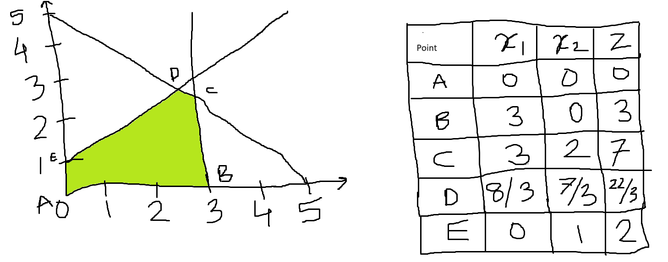

Cutting Plane Method
Maximize $−x_{1}+2x_{2}≤2$
Subject to $x_{1}+x_{2}≤5$, $x_{1}≤3$, $x_{1}{, x}_{2}≥O, x_{1, }x_{2}∈z$

Slide 8
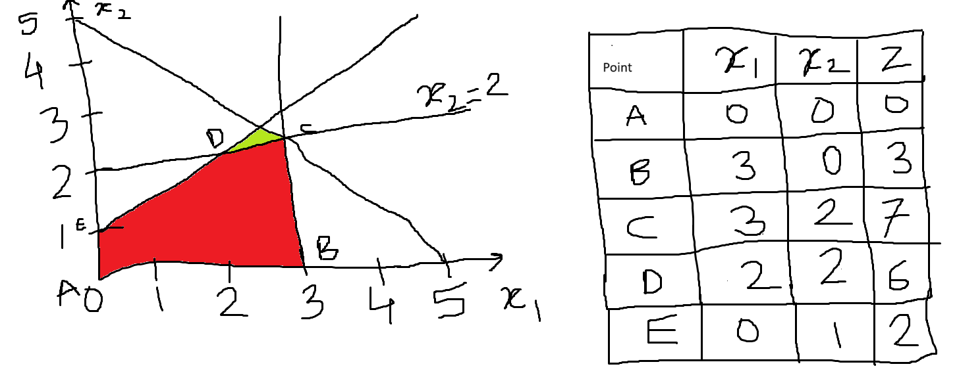
Cutting Plane Method
Solution is: z = 22/3, x1 = 8/3, x2 = 7/3
Optimal Solution is:
Z = 7, x1 = 3, x2 = 2

Slide 9

Branch and Cut Method
This is a combination of Branch and Bound (tree-based exploration) and Cutting planes (adding cuts)
Step – 1
x = 1.2, y = 1.2, z = 2.4
Step – 2
Let’s add the cut
$$x+y≤2$$
Now, possible solution might be (1, 1) – integer
No need to branch

Slide 10
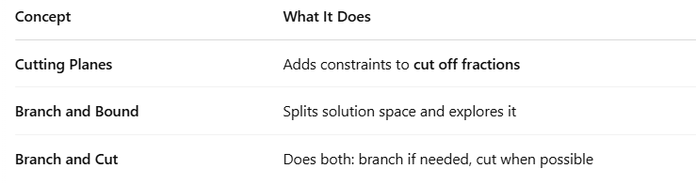
Recap

Slide 11
Academic Poll
What is the main goal of the "Cutting Plane" method in integer programming?
A) To linearize non-linear functions B) To avoid using matrices C) To eliminate non-integer solutions by adding new constraints D) To randomly generate feasible solutions
In the Branch and Bound algorithm, what does "bounding" mean?
A) Assigning random values to variables B) Estimating upper or lower limits of the objective function C) Eliminating integer constraints D) Duplicating the problem into subproblems
What is the major drawback of solving integer programming problems using only LP relaxation?
A) LP is slower than integer programming B) LP always finds incorrect objective values C) LP relaxation may return fractional solutions D) LP can't handle more than two variables

Slide 12
Academic Poll
What is the main goal of the "Cutting Plane" method in integer programming?
A) To linearize non-linear functions B) To avoid using matrices C) To eliminate non-integer solutions by adding new constraints D) To randomly generate feasible solutions
In the Branch and Bound algorithm, what does "bounding" mean?
A) Assigning random values to variables B) Estimating upper or lower limits of the objective function C) Eliminating integer constraints D) Duplicating the problem into subproblems
What is the major drawback of solving integer programming problems using only LP relaxation?
A) LP is slower than integer programming B) LP always finds incorrect objective values C) LP relaxation may return fractional solutions D) LP can't handle more than two variables

Slide 13
Session Summary
In this session, we have discussed about:
Integer Programming Problems
Different algorithms to solve IPP

Slide 14

Happy Learning!

